Slide 1


Department of Computer Science and Engineering
CS191P11 – IOT
RFID BASED DOOR LOCK SYSTEM
Vikram S – 210701504 Kumaravel N - 210701127

Slide 2
Abstract
This project presents the design and development of a secure and user-friendly door access control system utilizing Radio Frequency Identification (RFID) technology. The system offers convenient keyless entry for authorized personnel while maintaining robust security measures. It achieves this through a combination of RFID tag verification and a real-time alert mechanism.The core functionality revolves around an RFID reader positioned near the door. Users gain access by presenting a designated RFID tag, typically a key fob or card, to the reader. The system employs a microcontroller unit (MCU) to interact with the reader and manage the access control process. Upon detecting a tag, the MCU retrieves the unique identifier associated with it. This identifier is then compared against a pre-programmed database of authorized users stored within the system's memory. If the scanned tag matches a valid user, the MCU transmits a signal to the door lock, triggering its release and granting access.

Slide 3
Introduction
This project proposes a secure and user-centric door access control system utilizing Radio Frequency Identification (RFID) technology. It prioritizes convenience with keyless entry for authorized personnel while maintaining robust security.
This is achieved through a combination of RFID tag verification and a real-time alert mechanism. Further development could explore integration with existing security systems for comprehensive monitoring and advanced access management functionalities like user access logs and temporary access control.
It prioritizes user convenience with keyless entry and enhanced security through real-time SMS alerts for unauthorized access (GSM module).
It provides a convincing solution for varied access control requirements in a variety of settings, including residential buildings, offices, and restricted locations.

Slide 4
Literature Survey
In [1],Door access control systems play a crucial role in safeguarding physical security. Traditional methods using physical keys are prone to loss or duplication. RFID technology offers a compelling alternative, providing keyless entry with enhanced security and convenience. This survey explores existing research on RFID-based door access control systems, focusing on real-time alert mechanisms for unauthorized access attempts.
In [2], One system integrates RFID tags with a central server for user authentication and access control, replacing physical keys with secure and convenient tags. Another utilizes an RFID reader and an electromagnetic lock, incorporating a GSM module for sending SMS alerts upon unauthorized access attempts, demonstrating a basic real-time alert mechanism.

Slide 5
Literature Survey
In [3], Research has delved into advancements in user authentication and access management. An Arduino-based system for RFID tag verification and door access control emphasizes the ease of implementation using readily available platforms.
In [4], It explores various RFID tag types (active vs. passive) for access control applications, highlighting the importance of understanding tag characteristics for optimal system design.

Slide 6
Problem Statement
This project explores an Arduino Uno-based RFID access control system. It prioritizes user convenience with keyless entry and enhanced security through real-time SMS alerts for unauthorized access (GSM module).
This innovative approach streamlines access control and offers a compelling solution for various environments. Further development could explore integration with existing security systems for advanced management features.

Slide 7
Proposed Work
The proposed work is an IOT enabled system that utilizes GSM module for communication with the user.
The data obtained from the sensors is then used to detect if the RFID Tag / Card is authorized or not. The RFID Tag / Card hosts the details of the user.
The main component used includes Arduino UNO which is connected to a collection of other sensors such as RFID Sensor for authentication and actuators such as Micro Servo motor, GSM SIM800L , Buzzer and LEDs for identification.

Slide 8
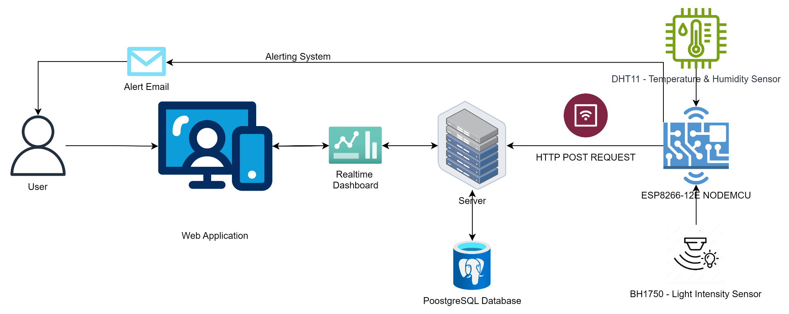
System Architecture

Slide 9
Methodology
RFID Module:
This is the core model for user authentication and keyless entry. It involves RFID tags carried by authorized personnel and an RFID reader at the access point. The reader transmits radio waves to identify and verify the tags, granting access to those with valid credentials..
Microcontroller Module:
The Arduino Uno acts as the brain of the system, processing data from the RFID reader and controlling the door lock mechanism. It verifies the tag ID against a stored list of authorized users and triggers the appropriate action based on the verification outcome.
Communication Module (GSM Module):
The Communiction module enables the system to send SMS notifications to a designated phone number upon unauthorized access attempts. This real-time communication enhances security by informing personnel about potential security breaches.

Slide 10
Methodology
Access Control Module:
This overarching module governs the entire system's functionality. It defines the rules and protocols for user access, including authorized personnel, access times (if applicable), and the response to unauthorized attempts.The Access Control Model essentially determines who can enter, when they can enter, and where within the controlled area they can go. It acts as the central authority, ensuring the system grants access only to authorized personnel under the appropriate circumstances. This model interacts with other models in the system, like the RFID model for user identification and the microcontroller model for access control decisions.

Slide 11
Results and Discussion
This project demonstrably built a user-friendly and secure RFID-based door access control system with real-time alerts.
Key components include IOT sensor selection, software development for communication, setting up the network, providing real-time access to data and sending alerts the user when there is a possible intruder.

Slide 12
Conclusion
RFID access control system with real-time alerts is secure and user-friendly. Future upgrades are exciting! Integrating with building management systems creates a central hub for access monitoring, streamlining security. Advanced user management with roles ensures personnel only access authorized areas. Adding biometrics like fingerprints strengthens security further. A mobile app for unlocking doors and receiving alerts enhances user convenience. We can also implement two-factor authentication and tamper detection for even stronger security. Data logging and reporting will aid security audits.

Slide 13
References
Chit, M. M. T., Srisiri, W., Siritantikorn, A., Kongruttanachok, N., & Benjapolakul, W. (2021, December). Application of RFID and IoT technology into specimen logistic system in the healthcare sector. In 2021 3rd International Conference on Advancements in Computing (ICAC) (pp. 7-12). IEEE.
Makanjuola, O. A., Abegunde, O. O., Adedoyin, O. M., & Olatinwo, D. A. (2022, June). An Rfid-Based Access Control System Using Electromagnetic Door Lock and an Intruder Alert System. Journal of Electrical and Electronic Engineering, 22(11), 7-17.
Thornton, Frank, and Chris Lanthem. RFID security. Elsevier, 2006.
Rieback, Melanie R., Bruno Crispo, and Andrew S. Tanenbaum. "The evolution of RFID security." IEEE Pervasive Computing 5, no. 01 (2006):62-69.
Pateriya, R. K., and Sangeeta Sharma. "The evolution of RFID security and privacy: A research survey." In 2011 International Conference on Communication Systems and Network Technologies, pp. 115-119. IEEE, 2011

Slide 14
Thank You

